Slide 1
205 Jan 17, Class 6
Chapter 5, Statistics
Descriptive statistics
Inferential statistics
Data visualization
Practical approaches
Calculating statistics
Reporting statistics
Data visualization

Slide 2
Descriptive statistics for Exp 1
Working with spreadsheets
Selecting cells, selecting ranges, entering formulas
Mean
=average()
Standard deviation
=stdev.s()
Standard error
SD/sqrt(n)
Counting n
Building a formula

Slide 3
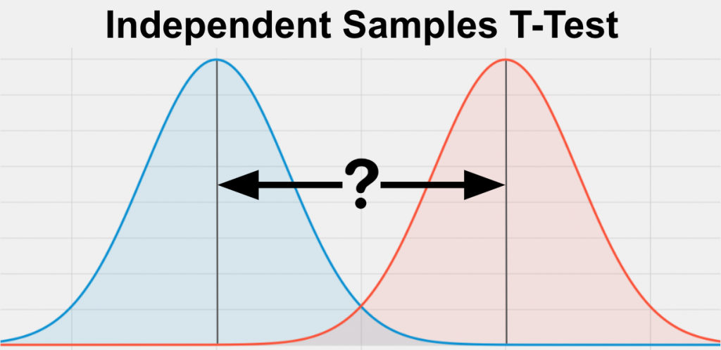
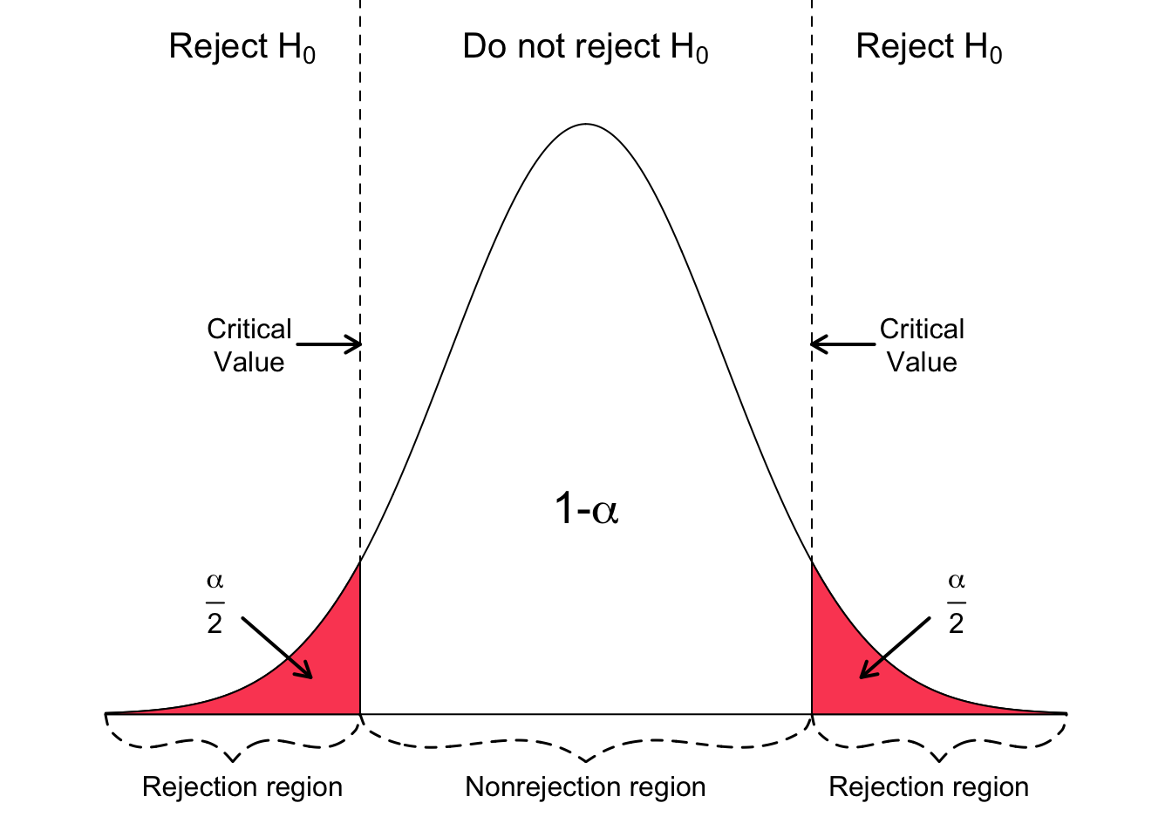
Theory: t-test
t = mean difference / variance
Data distributions for two conditions

Slide 4
Practical Inferential Statistics
Running a t-test on data
Two independent samples t-test
Assuming equal variances
Applying a 2-tailed criterion
Alpha = .05
Software
R & RStudio – free, highly accurate
SPSS – expensive, highly accurate
MS Excel – available, slightly inaccurate

Slide 5
Using R
Installing R
Installing RStudio
Programming environment
Running commands
Multiple panes of information
Using the correctly formatted version of the data
The ‘.csv’ file is set up slightly differently
Following the given recipe
Once everything is configured, just Run->

Slide 6
Reading statistical output
All statistical programs produce a lot of information
Communicating the results
Parsing the output
Selecting the correct values
Reporting in APA format
t(df) = X.XX, p < .YYY
t(df) = X.XX, p = .yyy

Slide 7
Writing your results section
Includes both descriptive and inferential statistics
Give the performance of both groups
State the direction of the effect
Support with inferential statistics
Very compact, but high-risk
Triple check your numbers

Slide 8
Fill in the reporting template
“On the recognition test, the Condition-A participants exhibited performance of XXX [units] (SD XX; SE XX) while the Condition-B participants exhibited performance of XXX [units] (SD XX; SE XX). The Condition-A group performed significantly better than the Condition-B group, t(xx)=ZZZ, p<YYY.”
Replace
Condition-A, Condition-B
Optionally: ‘exhibited performance’
Include ‘units’
Add all the numbers, descriptive and inferential

Slide 9
Making a figure
Back to Excel
Getting a basic graph is straightforward
Necessary edits
Label the y-axis
Add SE bars
Recommended edits
Remove title, gridlines
Optional edits
Colors, layout, design

Slide 10
For Fri Jan 19
Chapter 6, Writing in APA format
Chapter 7, Within-participants design
Short assignment
Start drafting your first writeup
Write your results section
Add your figure
Add your figure caption

Slide 11
205 Jan 17, Class 7
Chapter 6, APA format writing
Experiment 1 Methodology details
First writeup specific guidelines

Slide 12
APA Report Sections
Abstract
Very concise summary, ~200 words
Introduction
Construct, background, hypothesis
Methods
Participants, materials, procedure
Results
Figure
Discussion
Conclusion, interpretation, limitations
References

Slide 13
APA Format: Methods
Which of the following is the main goal of the Methods section of a research report?
a. Meticulously articulate how you analyzed the data.
b. Provide enough detail to allow an independent researcher to replicate your study.
c. Outline the demographic information of your participants so that reviewers can access the generalizability of your research.
d. Discuss the procedure you used so that readers can decide for themselves if your protocol is biased.

Slide 14
APA Format: Results
Which of the following is usually beyond the scope of the Results section of a quantitative research report?
a. Discussing what statistical techniques were used
b. Presenting figures and/or tables to portray the data
c. Providing detailed interpretation of the implications based on the data
d. Presenting specific statistics that were generated from the data

Slide 15
APA Format: Discussion
If you state alternative explanations in your discussion, which of the following should you also consider doing?
a. Tell readers why the alternative explanation falls short of the primary explanation
b. Conduct statistics tests to test them specifically
c. Include reviewer opinions of whether they think the alternative explanation is better or worse than the primary explanation
d. Present a literature review that would allow readers to conduct a follow-up study based on the alternative explanation

Slide 16
APA Writing with Style
What is the role played by answering the question “who will you write for” in writing a research report? How should the answer influence the writing process?
Citing previous research
Craik & Tulving (1972) proposed that better memory would research from more semantic engagement with the material being studied and termed this “deeper” processing.

Slide 17
Background literature
APA format for the References section
Craik, F. I. M., & Lockhart, R. S. (1972). Levels of processing: A framework for memory research. Journal of verbal learning and verbal behavior, 11(6), 671-684.
Craik, F. I. M., & Tulving, E. (1975). Depth of processing and the retention of words in episodic memory. Journal of experimental Psychology: general, 104(3), 268.
Notes:
Demonstrate use of google scholar

Slide 18
Theory: “Deep” Encoding
Hypothesis
What is it?
What isn’t it?
Mechanism
Inferred
Specific Procedures
Used in studies to test
Combination of testing operational definitions and underlying theory
What if our study hadn’t worked?

Slide 19
Research Context
Building on existing work
Strengthens confidence in conclusions
Very briefly review theory/mechanism
Adding something new
What is new about our study?
Motivate the current study to add to prior work

Slide 20
Experiment 1 Methods information
Participants
48 students from Research Methods classes
Materials
A set of 60 words was used for the study and test stimuli. Words were selected to have a written frequency of 30-80 per million and to be 5-8 letters in length.
Procedure
4s time per word to rate (automatic advance)
“For each word, rate how much you like the word on a 1 to 5 scale. 5 means you like the word very much and 1 means you dislike the word very much. Indicate your rating with keyboard or mouse.”
“For each word, count the number of vowels in each word. Enter the number with keyboard or mouse"
3m delay period completing trivia questions
60 item post-test, 30 old, 30 new

Slide 21
Results
Include all of:
Descriptive statistics: mean, SD, SE
Inferential statistics: t-test in APA format
Figure & caption
As discussed in class, will be very compact

Slide 22
First writeup
Include title page, abstract
Introduction: 1-2 paragraphs citing prior work, noting what is new about this study
Methods: full detail
Results: full detail including Figure and caption
Discussion: 1-2 paragraphs summarizing conclusion, note limitations
Finish on strong positive statement!
References:

Slide 23
For Fri Jan 19
For class: Chapter 7, within-participants design
Shorter chapter, very brief assignment
By end of day: First writeup of in-class Experiment 1

